Slide 1
Oracle Application Express (APEX)
Project Implementation for
COSC 5050 Distributed Database Applications
Lab1

Slide 2
Introduction to Oracle APEX
What is Oracle APEX?
Browser based application development environment
No client software to develop, deploy, or run applications
Full service: application building, SQL workshop, utilities

Slide 3
Application Express – Declarative
No code is generated
You write some SQL and optionally PL/SQL snippets
Declarative development yields fewer differences between developers
Less risk for developer introduced security issues
Meta data driven

Slide 4
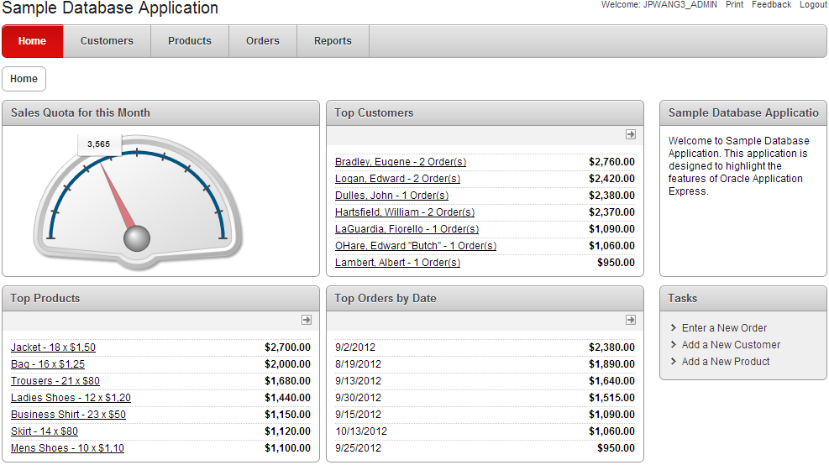
What is APEX?
APEX is an IDE and a runtime environment
Write web applications
Run applications

Slide 5
Integrate with Database
Oracle Application Express is a rapid Web application development tool for the Oracle database.
Develop professional applications that are both fast and secure
User interface themes, navigational controls, form handlers, and flexible reports

Slide 6
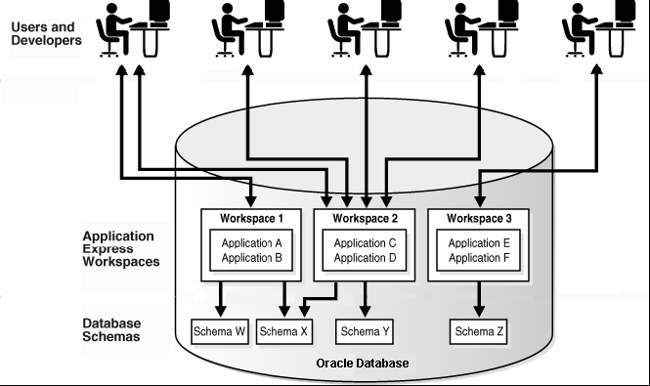
APEX Workspace
A workspace is a virtual private database that enables multiple users to work within the same Oracle Application Express installation while keeping their objects, data, and applications private

Slide 7
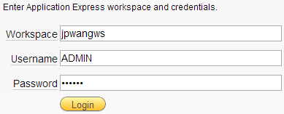
Access Oracle APEX Workspace
The APEX address for CRONUS server is:
http://icarusweb.webster.edu/pls/apex
Enter APEX workspace with following parameters:
Workspace = {workspace name created by administrator}
Username = {username for the workspace}
Password = {password for the workspace}

Slide 8
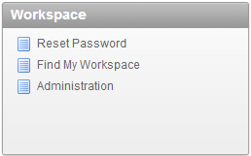
Access Oracle APEX Workspace
Your Webster email address can be used
To find out workspace name and username
To reset login password

Slide 9
Oracle APEX Documentation
Oracle Application Express documentation and tutorials can be found and PDF files can be downloaded from here:
http://mercury.webster.edu/wang/APEX/index.html

Slide 10
APEX User Roles
Workspace administrator
Perform administrator tasks specific to a workspace
Managing user accounts, monitoring workspace activities
Developer
Create and edit applications
End user
Have no development privileges
End users are defined so that they can access applications
Oracle Application Express administrator
Super user that manages an entire hosted instance using the Application Express Administration Services

Slide 11
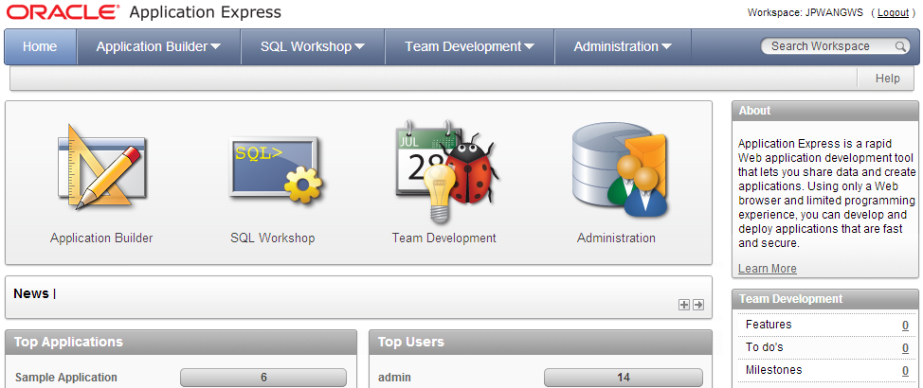
APEX Workspace

Slide 12
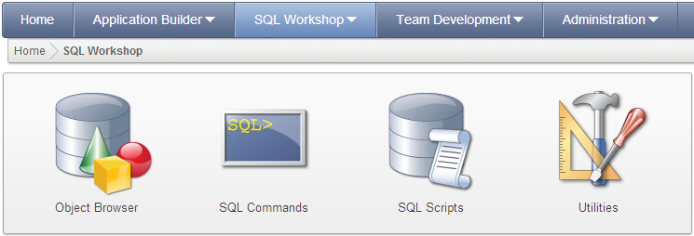
Using SQL Workshop
Object browser
SQL command processor
SQL scripts
Utilities

Slide 13
Using SQL Workshop
Object Browser
View, create, modify, browse, and drop database objects
SQL Commands
Run SQL commands and anonymous PL/SQL, and scripts
SQL Scripts
Create, edit, view, run, and delete script files
Upload and download scripts from your local file system
Utilities
Build queries, generate DDL and object reports, and others

Slide 14
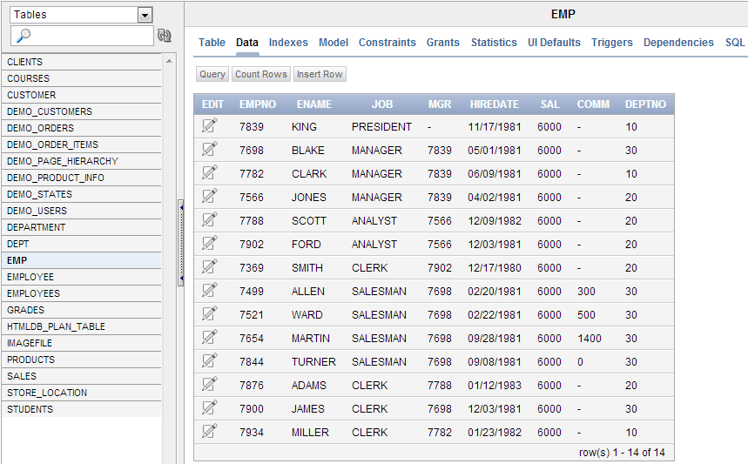
Object Browser

Slide 15
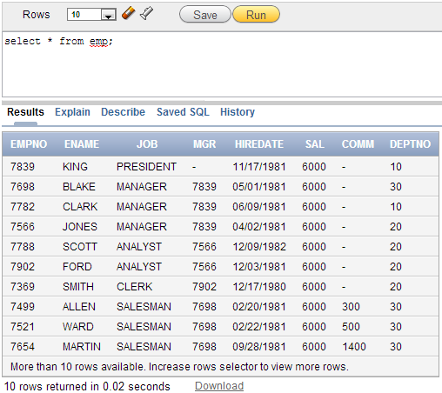
SQL Commands

Slide 16
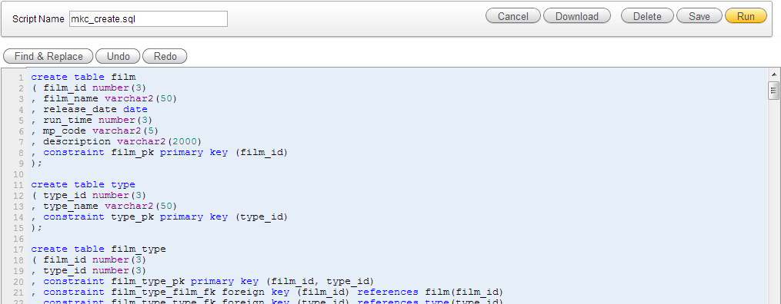
SQL Scripts

Slide 17
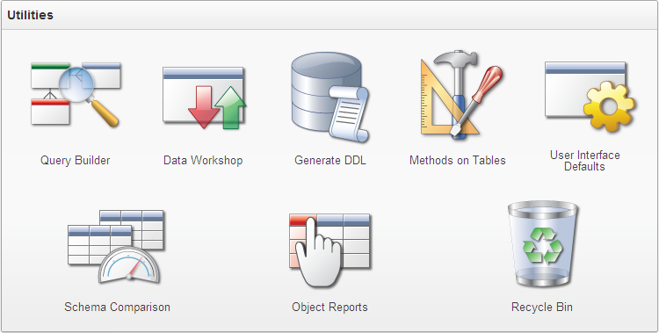
Utilities

Slide 18
Readings
10 Questions on Oracle Application Express
Oracle Database 2 Day + Application Express Developer’s Guide
Oracle Application Express SQL Workshop and Utilities Guide

